Slide 1
Senior English with Mrs. Greblo!
Welcome back to…
2012-2013

Slide 2
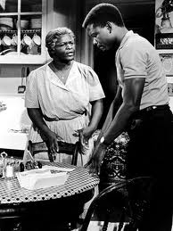
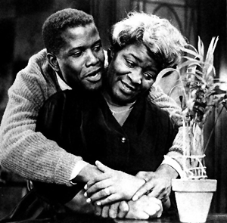

Slide 3
Daily SSR Entry:
Each entry contains:
-Date
-Book title & author
-Starting page # (SP)
-Ending page # (EP) -Total # of pages read
-Reader’s Statement (RS):
What’s happening in the book? Summarize.
What do you predict will happen next?
What questions do you have for the author?
What character traits do you appreciate? Find frustrating?
What is your opinion of the book so far?
Other comments?
Sample Entry:
9/17/12
The Hunger Games by Suzanne Collins
SP: 1
EP: 20
Total: 20
RS: Katniss lives in District 12 of the former U.S., now Panem with her sister, Prim and her Mom. She is an agile hunter and gatherer and has had to do so since her father’s tragic death in a mine explosion. The reaping is today and the tone of District 12 is very somber as children ages 12-18 could be drawn to defend themselves to their death in the Hunger Games. I predict that Katniss or one of her close friends or family members names will be drawn. This book is really suspenseful, I’m loving it so far!

Slide 4
Mrs. Greblo’s 1B Senior English Agenda: 4/17/13
Please copy this agenda down into your Learning Log Notebook, you will receive credit for it!
Absentees from Monday see me, please!
SSR / Attendance / get LLN and/or writing folders from the cabinet, QUIETLY
Daily SSR Entry #15
Daily SSR Pair Share
Agenda #15
Reminders:
Get your Article Review #1 & #2 assignments TURNED IN ASAP!!
(finish) Persepolis Essential Question Carousel Activity Wrap-up
Unit Pre-assessment:
Harlem by Langston Hughes
“I Have a Dream” speech by MLK Jr.
Discussion
Put away your LLN and/or writing folders in the LLN Storage File Cabinet NEATLY, please!
Objective(s):
Listen attentively
Draw conclusions about reasons for actions/beliefs and support assertions
Reveal the significance of the subject and events
Write expressively in one of the four writing modes in an uninhibited manner
Relate A Raisin in the Sun to the greater theme of African American literature
Identify and explain the themes of the play, and discuss how they are developed
Homework: for next class…
Feel free to return your senior English textbook, we don’t need it anymore!
Bring your SSR book to class every day!
Visit www.glencoecounseling.weebly.com

Slide 5
Full List of Unit Objectives
Explain Hansberry’s use of allusions and symbolism as literary techniques.
Identify theatrical conventions, such as monologues and stage directions, and explain how Hansberry uses them.
compare and contrast differing viewpoints on heritage, assimilationism, and Afrocentrism.
identify and explain the themes of the play, and discuss how they are developed.
discuss the growth of the relationship between Ruth and Walter.
analyze character growth of all major characters in the play.
discuss differing viewpoints on Caucasian oppression in the 1950s and how these affected poor African-American families.
identify events and characters based on Hansberry’s own life.
discuss the differences of opinion among the Youngers, Mrs. Johnson, and George Murchison in relation to the pursuit of dreams.
analyze parallels that Hansberry draws between characters’ viewpoints and the significance of those parallels.

